Slide 2
CS276A
Text Retrieval and Mining
Lecture 1

Slide 3
Query
Which plays of Shakespeare contain the words Brutus AND Caesar but NOT Calpurnia?
One could grep all of Shakespeare’s plays for Brutus and Caesar, then strip out lines containing Calpurnia?
  Slow (for large corpora)
  NOT Calpurnia is non-trivial
  Other operations (e.g., find the word Romans near countrymen) not feasible

Slide 4
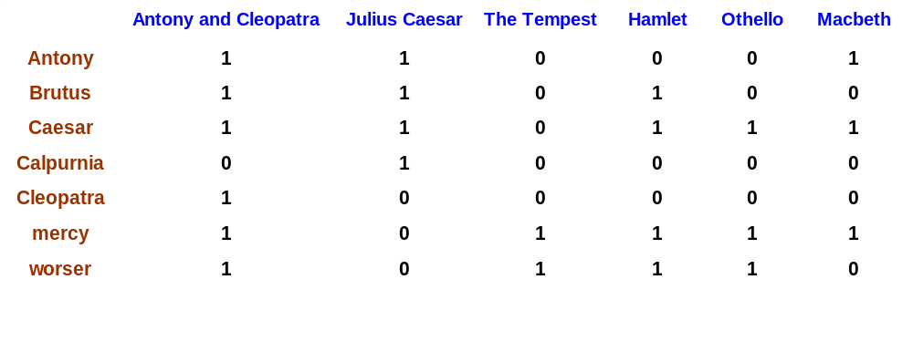
Term-document incidence
1 if play contains word, 0 otherwise
Brutus AND Caesar but NOT Calpurnia

Slide 5
Incidence vectors
So we have a 0/1 vector for each term.
To answer query: take the vectors for Brutus, Caesar and Calpurnia (complemented) ➔ bitwise AND.
110100 AND 110111 AND 101111 = 100100.

Slide 6
Answers to query
Antony and Cleopatra, Act III, Scene ii
Agrippa [Aside to DOMITIUS ENOBARBUS]: Why, Enobarbus,
When Antony found Julius Caesar dead,
He cried almost to roaring; and he wept
When at Philippi he found Brutus slain.
Hamlet, Act III, Scene ii
Lord Polonius: I did enact Julius Caesar I was killed i' the
Capitol; Brutus killed me.

Slide 7
Bigger corpora
Consider n = 1M documents, each with about 1K terms.
Avg 6 bytes/term incl spaces/punctuation
  6GB of data in the documents.
Say there are m = 500K distinct terms among these.

Slide 8
Can’t build the matrix
500K x 1M matrix has half-a-trillion 0’s and 1’s.
But it has no more than one billion 1’s.
  matrix is extremely sparse.
What’s a better representation?
  We only record the 1 positions.
Why?

Slide 9
Inverted index
For each term T, we must store a list of all documents that contain T.
Do we use an array or a list for this?
Brutus
2
4
8
16
32
64
128
Calpurnia
1
2
3
5
8
13
21
34
Caesar
13
16
What happens if the word Caesar is added to document 14?

Slide 10
Inverted index
Linked lists generally preferred to arrays
  Dynamic space allocation
  Insertion of terms into documents easy
  Space overhead of pointers
Brutus
2
4
8
16
32
64
128
Calpurnia
1
2
3
5
8
13
21
34
Caesar
13
16
Dictionary
Postings
Sorted by docID (more later on why).

Slide 11





Inverted index construction
Documents to
be indexed.
Friends, Romans, countrymen.
Tokenizer
Token stream.
Friends
Romans
Countrymen
More on
these later.
Linguistic modules
Modified tokens.
friend
roman
countryman
Indexer
friend
2
4
roman
1
2
Inverted index.
countryman
13
16

Slide 12
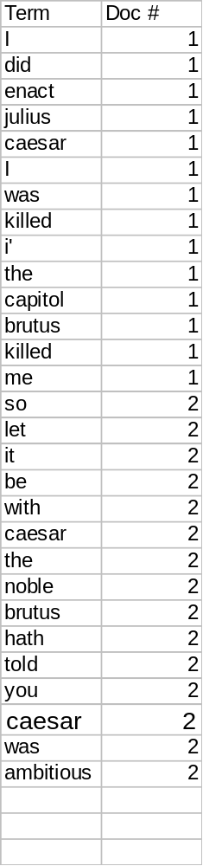
Indexer steps
Sequence of (Modified token, Document ID) pairs.
Doc 1
Doc 2
I did enact Julius
Caesar I was killed
i' the Capitol;
Brutus killed me.
So let it be with
Caesar. The noble
Brutus hath told you
Caesar was ambitious

Slide 13
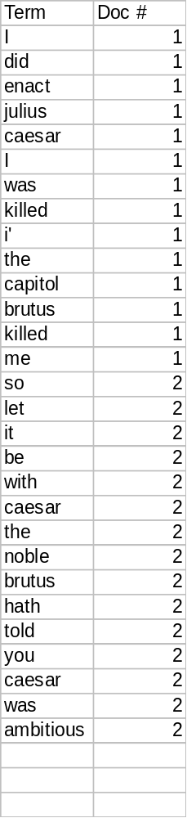
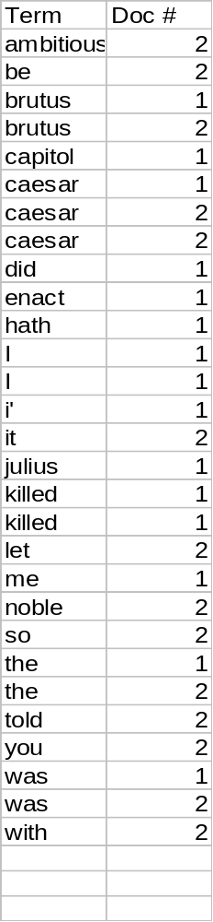
Sort by terms.
Core indexing step.

Slide 14
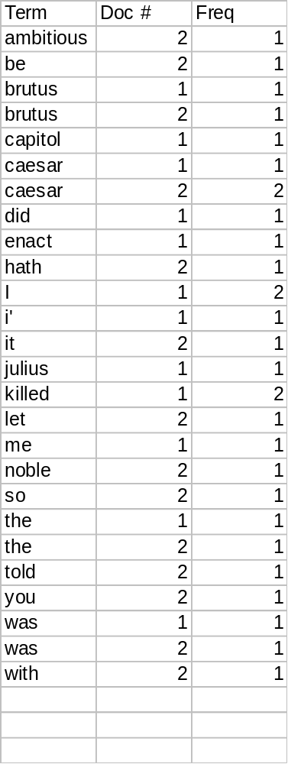
Multiple term entries in a single document are merged.
Frequency information is added.
Why frequency?
Will discuss later.

Slide 15
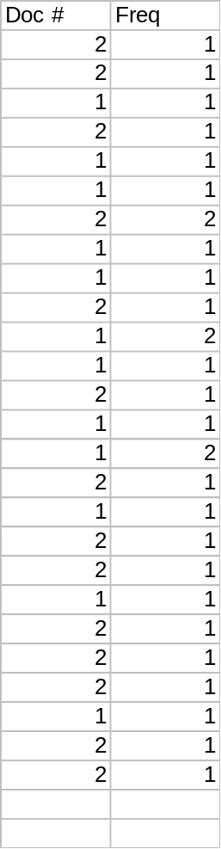
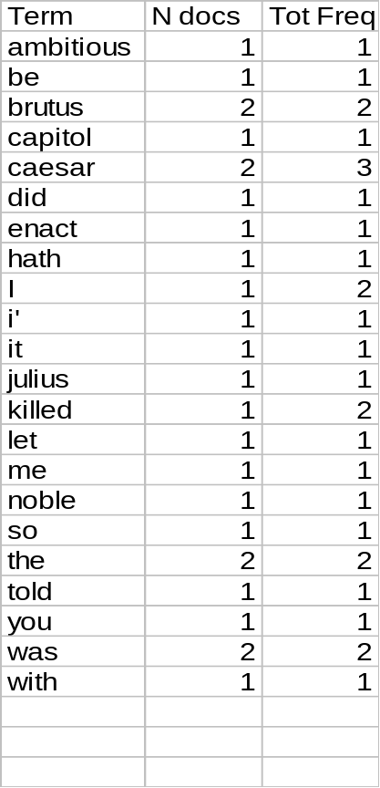
The result is split into a Dictionary file and a Postings file.

Slide 16
Where do we pay in storage?
Will quantify the storage, later.
Terms
Pointers

Slide 17
The index we just built
Today’s focus
How do we process a query?
  Later - what kinds of queries can we process?

Slide 18
Query processing
Consider processing the query:
  Brutus AND Caesar
  Locate Brutus in the Dictionary;
    Retrieve its postings.
  Locate Caesar in the Dictionary;
    Retrieve its postings.
  “Merge” the two postings:
2
4
8
16
32
64
128
Brutus
1
2
3
5
8
13
21
34
Caesar

Slide 19
The merge
Walk through the two postings simultaneously, in time linear in the total number of postings entries
2
2
4
4
8
8
16
16
32
64
128
32
64
128
Brutus
2
8
1
Caesar
1
2
2
3
5
5
8
8
13
13
21
21
34
3
34
If the list lengths are x and y, the merge takes O(x+y)
operations.
Crucial: postings sorted by docID.

Slide 20
Boolean queries: Exact match
Boolean Queries are queries using AND, OR and NOT together with query terms
  Views each document as a set of words
  Is precise: document matches condition or not.
Primary commercial retrieval tool for 3 decades.
Professional searchers (e.g., lawyers) still like Boolean queries:
  You know exactly what you’re getting.

Slide 21
Example: WestLaw http://www.westlaw.com/
Largest commercial (paying subscribers) legal search service (started 1975; ranking added 1992)
About 7 terabytes of data; 700,000 users
Majority of users still use boolean queries
Example query:
  What is the statute of limitations in cases involving the federal tort claims act?
  LIMIT! /3 STATUTE ACTION /S FEDERAL /2 TORT /3 CLAIM
Long, precise queries; proximity operators; incrementally developed; not like web search

Slide 22
More general merges
Exercise: Adapt the merge for the queries:
Brutus AND NOT Caesar
Brutus OR NOT Caesar
Can we still run through the merge in time O(x+y)?

Slide 23
Merging
What about an arbitrary Boolean formula?
(Brutus OR Caesar) AND NOT
(Antony OR Cleopatra)
Can we always merge in “linear” time?
  Linear in what?
Can we do better?

Slide 24
Query optimization
What is the best order for query processing?
Consider a query that is an AND of t terms.
For each of the t terms, get its postings, then AND together.
Brutus
2
4
8
16
32
64
128
Calpurnia
1
2
3
5
8
16
21
34
Caesar
13
16
Query: Brutus AND Calpurnia AND Caesar

Slide 25
Query optimization example
Process in order of increasing freq:
  start with smallest set, then keep cutting further.
This is why we kept
freq in dictionary
Brutus
2
4
8
16
32
64
128
Calpurnia
1
2
3
5
8
13
21
34
Caesar
13
16
Execute the query as (Caesar AND Brutus) AND Calpurnia.

Slide 26
More general optimization
e.g., (madding OR crowd) AND (ignoble OR strife)
Get freq’s for all terms.
Estimate the size of each OR by the sum of its freq’s (conservative).
Process in increasing order of OR sizes.

Slide 27
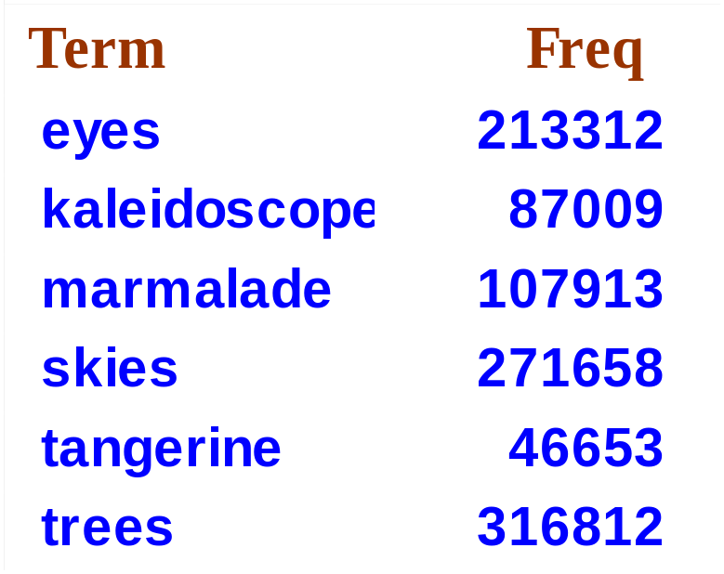
Exercise
Recommend a query processing order for
(tangerine OR trees) AND
(marmalade OR skies) AND
(kaleidoscope OR eyes)

Slide 28
Query processing exercises
If the query is friends AND romans AND (NOT countrymen), how could we use the freq of countrymen?
Exercise: Extend the merge to an arbitrary Boolean query. Can we always guarantee execution in time linear in the total postings size?
Hint: Begin with the case of a Boolean formula query: the each query term appears only once in the query.

Slide 29
Ranking search results
Boolean queries give inclusion or exclusion of docs.
Need to measure proximity from query to each doc.
Whether docs presented to user are singletons, or a group of docs covering various aspects of the query.

Slide 30
Structured vs unstructured data
Structured data tends to refer to information in “tables”
Employee
Manager
Salary
Smith
Jones
50000
Chang
Smith
60000
Ivy
Smith
50000
Typically allows numerical range and exact match
(for text) queries, e.g.,
Salary < 60000 AND Manager = Smith.

Slide 31
Unstructured data
Typically refers to free text
Allows
  Keyword queries including operators
  More sophisticated “concept” queries e.g.,
    find all web pages dealing with drug abuse
Classic model for searching text documents
Structured data has been the big commercial success [think, Oracle…] but unstructured data is now becoming dominant in a large and increasing range of activities [think, email, the web]

Slide 32
The web and its challenges
Unusual and diverse documents
Unusual and diverse users, queries, information needs
Beyond terms, exploit ideas from social networks
  link analysis, clickstreams ...

Slide 33
Corpus size for estimates
Consider n = 1M documents, each with about L=1K terms.
Avg 6 bytes/term incl spaces/punctuation
  6GB of data.
Say there are m = 500K distinct terms among these.

Slide 34
Don’t build the matrix
500K x 1M matrix has half-a-trillion 0’s and 1’s.
But it has no more than one billion 1’s.
  matrix is extremely sparse.
So we devised the inverted index
  Devised query processing for it
Where do we pay in storage?

Slide 35
Where do we pay in storage?
Terms
Pointers

Slide 36
Storage analysis
First will consider space for postings pointers
Basic Boolean index only
  Devise compression schemes
Then will do the same for dictionary
No analysis for positional indexes, etc.

Slide 37
Pointers: two conflicting forces
A term like Calpurnia occurs in maybe one doc out of a million - would like to store this pointer using log₂ 1M ~ 20 bits.
A term like the occurs in virtually every doc, so 20 bits/pointer is too expensive.
  Prefer 0/1 vector in this case.

Slide 38
Postings file entry
Store list of docs containing a term in increasing order of doc id.
  Brutus: 33,47,154,159,202 …
Consequence: suffices to store gaps.
  33,14,107,5,43 …
Hope: most gaps encoded with far fewer than 20 bits.

Slide 39
Variable encoding
For Calpurnia, will use ~20 bits/gap entry.
For the, will use ~1 bit/gap entry.
If the average gap for a term is G, want to use ~log₂G bits/gap entry.
Key challenge: encode every integer (gap) with ~ as few bits as needed for that integer.

Slide 40
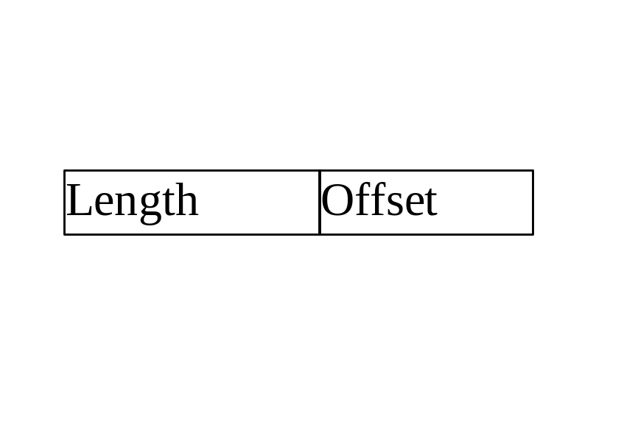
γ codes for gap encoding (Elias)
Represent a gap G as the pair <length,offset>
length is in unary and uses ⎣log₂G⎦ +1 bits to specify the length of the binary encoding of
offset = G - 2^{⎣log}₂^{G⎦} in binary.
Recall that the unary encoding of x is
a sequence of x 1’s followed by a 0.

Slide 41
γ codes for gap encoding
e.g., 9 represented as <1110,001>.
2 is represented as <10,1>.
Exercise: does zero have a γ code?
Encoding G takes 2 ⎣log₂G⎦ +1 bits.
  γ codes are always of odd length.

Slide 42
Exercise
Given the following sequence of γ−coded gaps, reconstruct the postings sequence:
1110001110101011111101101111011
From these γ−decode and reconstruct gaps,
then full postings.

Slide 43
What we’ve just done
Encoded each gap as tightly as possible, to within a factor of 2.
For better tuning (and a simple analysis) - need a handle on the distribution of gap values.

Slide 44
Wild-card queries

Slide 45
Wild-card queries: *
mon*: find all docs containing any word beginning “mon”.
Easy with binary tree (or B-tree) lexicon: retrieve all words in range: mon ≤ w < moo
*mon: find words ending in “mon”: harder
  Maintain an additional B-tree for terms backwards.
  Can retrieve all words in range: nom ≤ w < non.

Slide 46
Query processing
At this point, we have an enumeration of all terms in the dictionary that match the wild-card query.
We still have to look up the postings for each enumerated term.
E.g., consider the query:
se*ate AND fil*er
This may result in the execution of many Boolean AND queries.

Slide 47
B-trees handle *’s at the end of a query term
How can we handle *’s in the middle of query term?
  (Especially multiple *’s)
The solution: transform every wild-card query so that the *’s occur at the end
This gives rise to the Permuterm Index.

Slide 48
Permuterm index
For term hello index under:
  hello$, ello$h, llo$he, lo$hel, o$hell
  where $ is a special symbol.
Queries:
  X lookup on X$ X* lookup on X*$
  *X lookup on X$* *X* lookup on X*
  X*Y lookup on Y$X* X*Y*Z ???

Slide 49
Permuterm query processing
Rotate query wild-card to the right
Now use B-tree lookup as before.
Permuterm problem: ≈ quadruples lexicon size
Empirical observation for English.

Slide 50
Bigram indexes
Enumerate all k-grams (sequence of k chars) occurring in any term
e.g., from text “April is the cruelest month” we get the 2-grams (bigrams)
  $ is a special word boundary symbol
Maintain an “inverted” index from bigrams to dictionary terms that match each bigram.
$a,ap,pr,ri,il,l$,$i,is,s$,$t,th,he,e$,$c,cr,ru,
ue,el,le,es,st,t$, $m,mo,on,nt,h$

Slide 51
Bigram index example
$m
mace
madden
mo
among
amortize
on
among
around

Slide 52
Processing n-gram wild-cards
Query mon* can now be run as
  $m AND mo AND on
Fast, space efficient.
Gets terms that match AND version of our wildcard query.
But we’d enumerate moon.
Must post-filter these terms against query.
Surviving enumerated terms are then looked up in the term-document inverted index.

Slide 53
Processing wild-card queries
As before, we must execute a Boolean query for each enumerated, filtered term.
Wild-cards can result in expensive query execution
  Avoid encouraging “laziness” in the UI:
Search
Type your search terms, use ‘*’ if you need to.
E.g., Alex* will match Alexander.

Slide 54
Advanced features
Avoiding UI clutter is one reason to hide advanced features behind an “Advanced Search” button
It also deters most users from unnecessarily hitting the engine with fancy queries

Slide 55
Spelling correction

Slide 56
Spell correction
Two principal uses
  Correcting document(s) being indexed
  Retrieve matching documents when query contains a spelling error
Two main flavors:
  Isolated word
    Check each word on its own for misspelling
    Will not catch typos resulting in correctly spelled words e.g., from → form
  Context-sensitive
    Look at surrounding words, e.g., I flew form Heathrow to Narita.

Slide 57
Document correction
Primarily for OCR’ed documents
  Correction algorithms tuned for this
Goal: the index (dictionary) contains fewer OCR-induced misspellings
Can use domain-specific knowledge
  E.g., OCR can confuse O and D more often than it would confuse O and I (adjacent on the QWERTY keyboard, so more likely interchanged in typing).

Slide 58
Query mis-spellings
Our principal focus here
  E.g., the query Alanis Morisett
We can either
  Retrieve documents indexed by the correct spelling, OR
  Return several suggested alternative queries with the correct spelling
    Google’s Did you mean … ?

Slide 59
Isolated word correction
Fundamental premise – there is a lexicon from which the correct spellings come
Two basic choices for this
  A standard lexicon such as
    Webster’s English Dictionary
    An “industry-specific” lexicon – hand-maintained
  The lexicon of the indexed corpus
    E.g., all words on the web
    All names, acronyms etc.
    (Including the mis-spellings)

Slide 60
Isolated word correction
Given a lexicon and a character sequence Q, return the words in the lexicon closest to Q
What’s “closest”?
We’ll study several alternatives
  Edit distance
  Weighted edit distance
  n-gram overlap

Slide 61
Edit distance
Given two strings S₁ and S₂, the minimum number of basic operations to covert one to the other
Basic operations are typically character-level
  Insert
  Delete
  Replace
E.g., the edit distance from cat to dog is 3.
Generally found by dynamic programming.

Slide 62
Edit distance
Also called “Levenshtein distance”
See http://www.merriampark.com/ld.htm for a nice example plus an applet to try on your own

Slide 63
Weighted edit distance
As above, but the weight of an operation depends on the character(s) involved
  Meant to capture keyboard errors, e.g. m more likely to be mis-typed as n than as q
  Therefore, replacing m by n is a smaller edit distance than by q
  (Same ideas usable for OCR, but with different weights)
Require weight matrix as input
Modify dynamic programming to handle weights

Slide 64
Using edit distances
Given query, first enumerate all dictionary terms within a preset (weighted) edit distance
(Some literature formulates weighted edit distance as a probability of the error)
Then look up enumerated dictionary terms in the term-document inverted index
  Slow but no real fix
  Tries help
Better implementations – see Kukich, Zobel/Dart references.

Slide 65
n-gram overlap
Enumerate all the n-grams in the query string as well as in the lexicon
Use the n-gram index (recall wild-card search) to retrieve all lexicon terms matching any of the query n-grams
Rank by number of matching n-grams
Variants – weight by keyboard layout, etc.

Slide 66
Example with trigrams
Suppose the text is november
  Trigrams are nov, ove, vem, emb, mbe, ber.
The query is december
  Trigrams are dec, ece, cem, emb, mbe, ber.
So 3 trigrams overlap (of 6 in each term)
How can we turn this into a normalized measure of overlap?

Slide 67
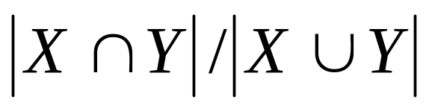
One option – Jaccard coefficient
A commonly-used measure of overlap
Let X and Y be two sets; then the J.C. is
Equals 1 when X and Y have the same elements and zero when they are disjoint
X and Y don’t have to be of the same size
Always assigns a number between 0 and 1
  Now threshold to decide if you have a match
  E.g., if J.C. > 0.8, declare a match

Slide 68
Caveat
Even for isolated-word correction, the notion of an index token is critical – what’s the unit we’re trying to correct?
In Chinese/Japanese, the notions of spell-correction and wildcards are poorly formulated/understood

Slide 69
Context-sensitive spell correction
Text: I flew from Heathrow to Narita.
Consider the phrase query “flew form Heathrow”
We’d like to respond
Did you mean “flew from Heathrow”?
because no docs matched the query phrase.

Slide 70
Context-sensitive correction
Need surrounding context to catch this.
  NLP too heavyweight for this.
First idea: retrieve dictionary terms close (in weighted edit distance) to each query term
Now try all possible resulting phrases with one word “fixed” at a time
  flew from heathrow
  fled form heathrow
  flea form heathrow
  etc.

Slide 71
Another approach
Break phrase query into a conjunction of biwords (lecture 2).
Look for biwords that need only one term corrected.
Enumerate phrase matches and … rank them!

Slide 72
General issue in spell correction
Will enumerate multiple alternatives for “Did you mean”
Need to figure out which one (or small number) to present to the user
Use heuristics
  The alternative hitting most docs
  Query log analysis + tweaking
    For especially popular, topical queries

Slide 73
Computational cost
Spell-correction is computationally expensive
Avoid running routinely on every query?
Run only on queries that matched few docs

Slide 74
Thesauri
Thesaurus: language-specific list of synonyms for terms likely to be queried
  car → automobile, etc.
  Machine learning methods can assist – more on this in later lectures.
Can be viewed as hand-made alternative to edit-distance, etc.

Slide 75
Query expansion
Usually do query expansion rather than index expansion
  No index blowup
  Query processing slowed down
    Docs frequently contain equivalences
  May retrieve more junk
    puma → jaguar retrieves documents on cars instead of on sneakers.

Slide 76
Soundex

Slide 77
Soundex
Class of heuristics to expand a query into phonetic equivalents
  Language specific – mainly for names
  E.g., chebyshev → tchebycheff

Slide 78
Soundex – typical algorithm
Turn every token to be indexed into a 4-character reduced form
Do the same with query terms
Build and search an index on the reduced forms
  (when the query calls for a soundex match)
http://www.creativyst.com/Doc/Articles/SoundEx1/SoundEx1.htm#Top

